Slide 1

Bioinformatics
Prof. William Stafford Noble
Department of Genome Sciences Department of Computer Science and Engineering
University of Washington
thabangh@gmail.com

Slide 2
One-minute responses
Be patient with us.
Go a bit slower.
It will be good to see some Python revision.
Coding aspect wasn’t clear enough.
What about if we don’t spend a lot of time on programming?
I like the Python part of the class.
Explain the second problem again.
More about software design and computation.
I don’t know what question we are trying to solve.
I didn’t understand anything.
More about how bioinformatics helps in the study of diseases and of life in general.
I am confused with the biological terms
We didn’t have a 10-minute break.

Slide 3
Introductory survey
2.34 Python dictionary
2.28 Python tuple
2.22 p-value
2.12 recursion
2.03 t test
1.44 Python sys.argv
1.28 dynamic programming
1.16 hierarchical clustering
1.22 Wilcoxon test
1.03 BLAST
1.00 support vector machine
1.00 false discovery rate
1.00 Smith-Waterman
1.00 Bonferroni correction

Slide 4
Outline
Responses and revisions from last class
Sequence alignment
Motivation
Scoring alignments
Some Python revision

Slide 5
Revision
What are the four major types of macromolecules in the cell?
Lipids, carbohydrates, nucleic acids, proteins
Which two are the focus of study in bioinformatics?
Nucleic acids, proteins
What is the central dogma of molecular biology?
DNA is transcribed to RNA which is translated to proteins
What is the primary job of DNA?
Information storage

Slide 6
How to provide input to your program
Add the input to your code.
DNA = “AGTACGTCGCTACGTAG”
Read the input from hard-coded filename.
dnaFile = open(“dna.txt”, “r”)
DNA = readline(dnaFile)
Read the input from a filename that you specify interactively.
dnaFilename = input(“Enter filename”)
Read the input from a filename that you provide on the command line.
dnaFileName = sys.argv[1]

Slide 7
Accessing the command line
Sample python program:
What will it do?
#!/usr/bin/python
import sys
for arg in sys.argv:
print(arg)
> python print-args.py a b c
print-args.py
a
b
c

Slide 8
Why use sys.argv?
Avoids hard-coding filenames.
Clearly separates the program from its input.
Makes the program re-usable.

Slide 9
DNA → RNA
When DNA is transcribed into RNA, the nucleotide thymine (T) is changed to uracil (U).
Rosalind: Transcribing DNA into RNA

Slide 10
#!/usr/bin/python
import sys
USAGE = """USAGE: dna2rna.py <string>
An RNA string is a string formed from the alphabet containing 'A',
'C', 'G', and 'U'.
Given a DNA string t corresponding to a coding strand, its
transcribed RNA string u is formed by replacing all occurrences of
'T' in t with 'U' in u.
Given: A DNA string t having length at most 1000 nt.
Return: The transcribed RNA string of t.
"""
print(sys.argv[1].replace("T","U"))

Slide 11
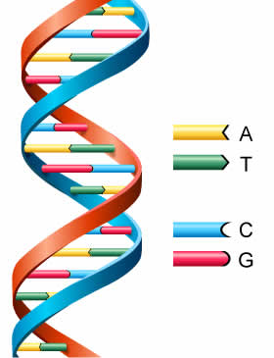
Reverse complement
TCAGGTCACAGTT
|||||||||||||
AACTGTGACCTGA

Slide 12
#!/usr/bin/python
import sys
USAGE = """USAGE: revcomp.py <string>
In DNA strings, symbols 'A' and 'T' are complements of each other,
as are 'C' and 'G'.
The reverse complement of a DNA string s is the string sc formed by
reversing the symbols of s, then taking the complement of each
symbol (e.g., the reverse complement of "GTCA" is "TGAC").
Given: A DNA string s of length at most 1000 bp.
Return: The reverse complement sc of s.
"""
revComp = { "A":"T", "T":"A", "G":"C", "C":"G" }
dna = sys.argv[1]
for index in range(len(dna) - 1, -1, -1):
char = dna[index]
if char in revComp:
sys.stdout.write(revComp[char])
sys.stdout.write("\n")

Slide 13
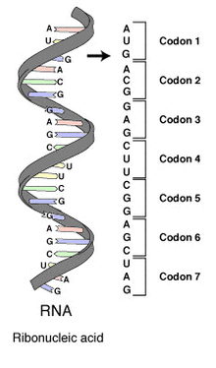
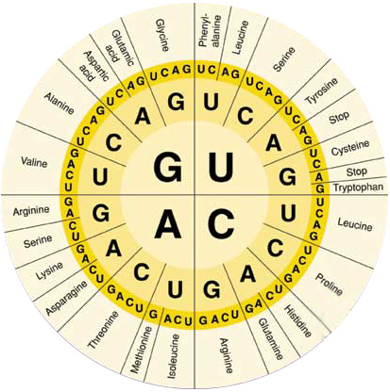
Universal genetic code
Protein structure

Slide 14
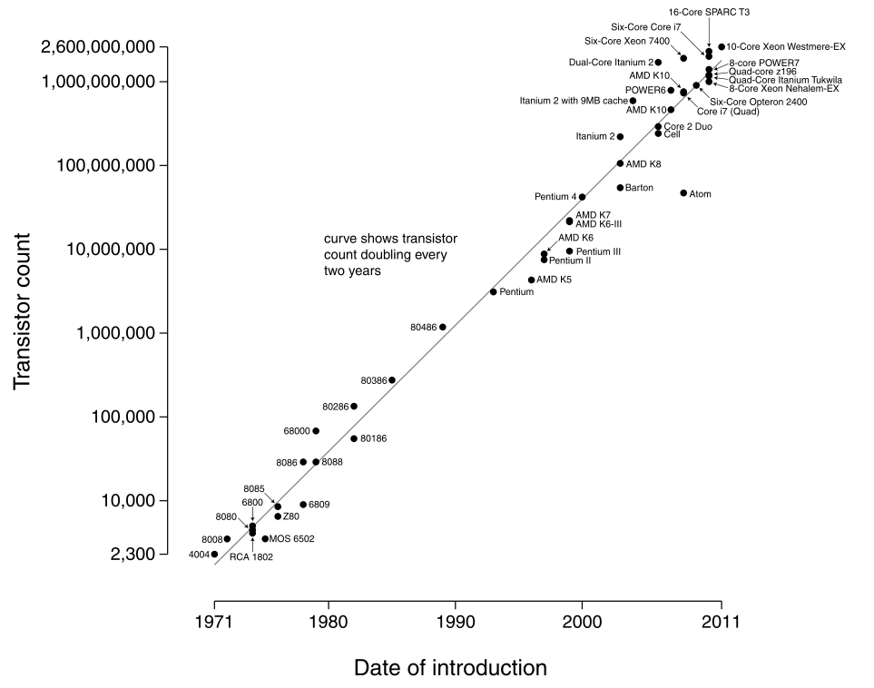
Moore’s law

Slide 15
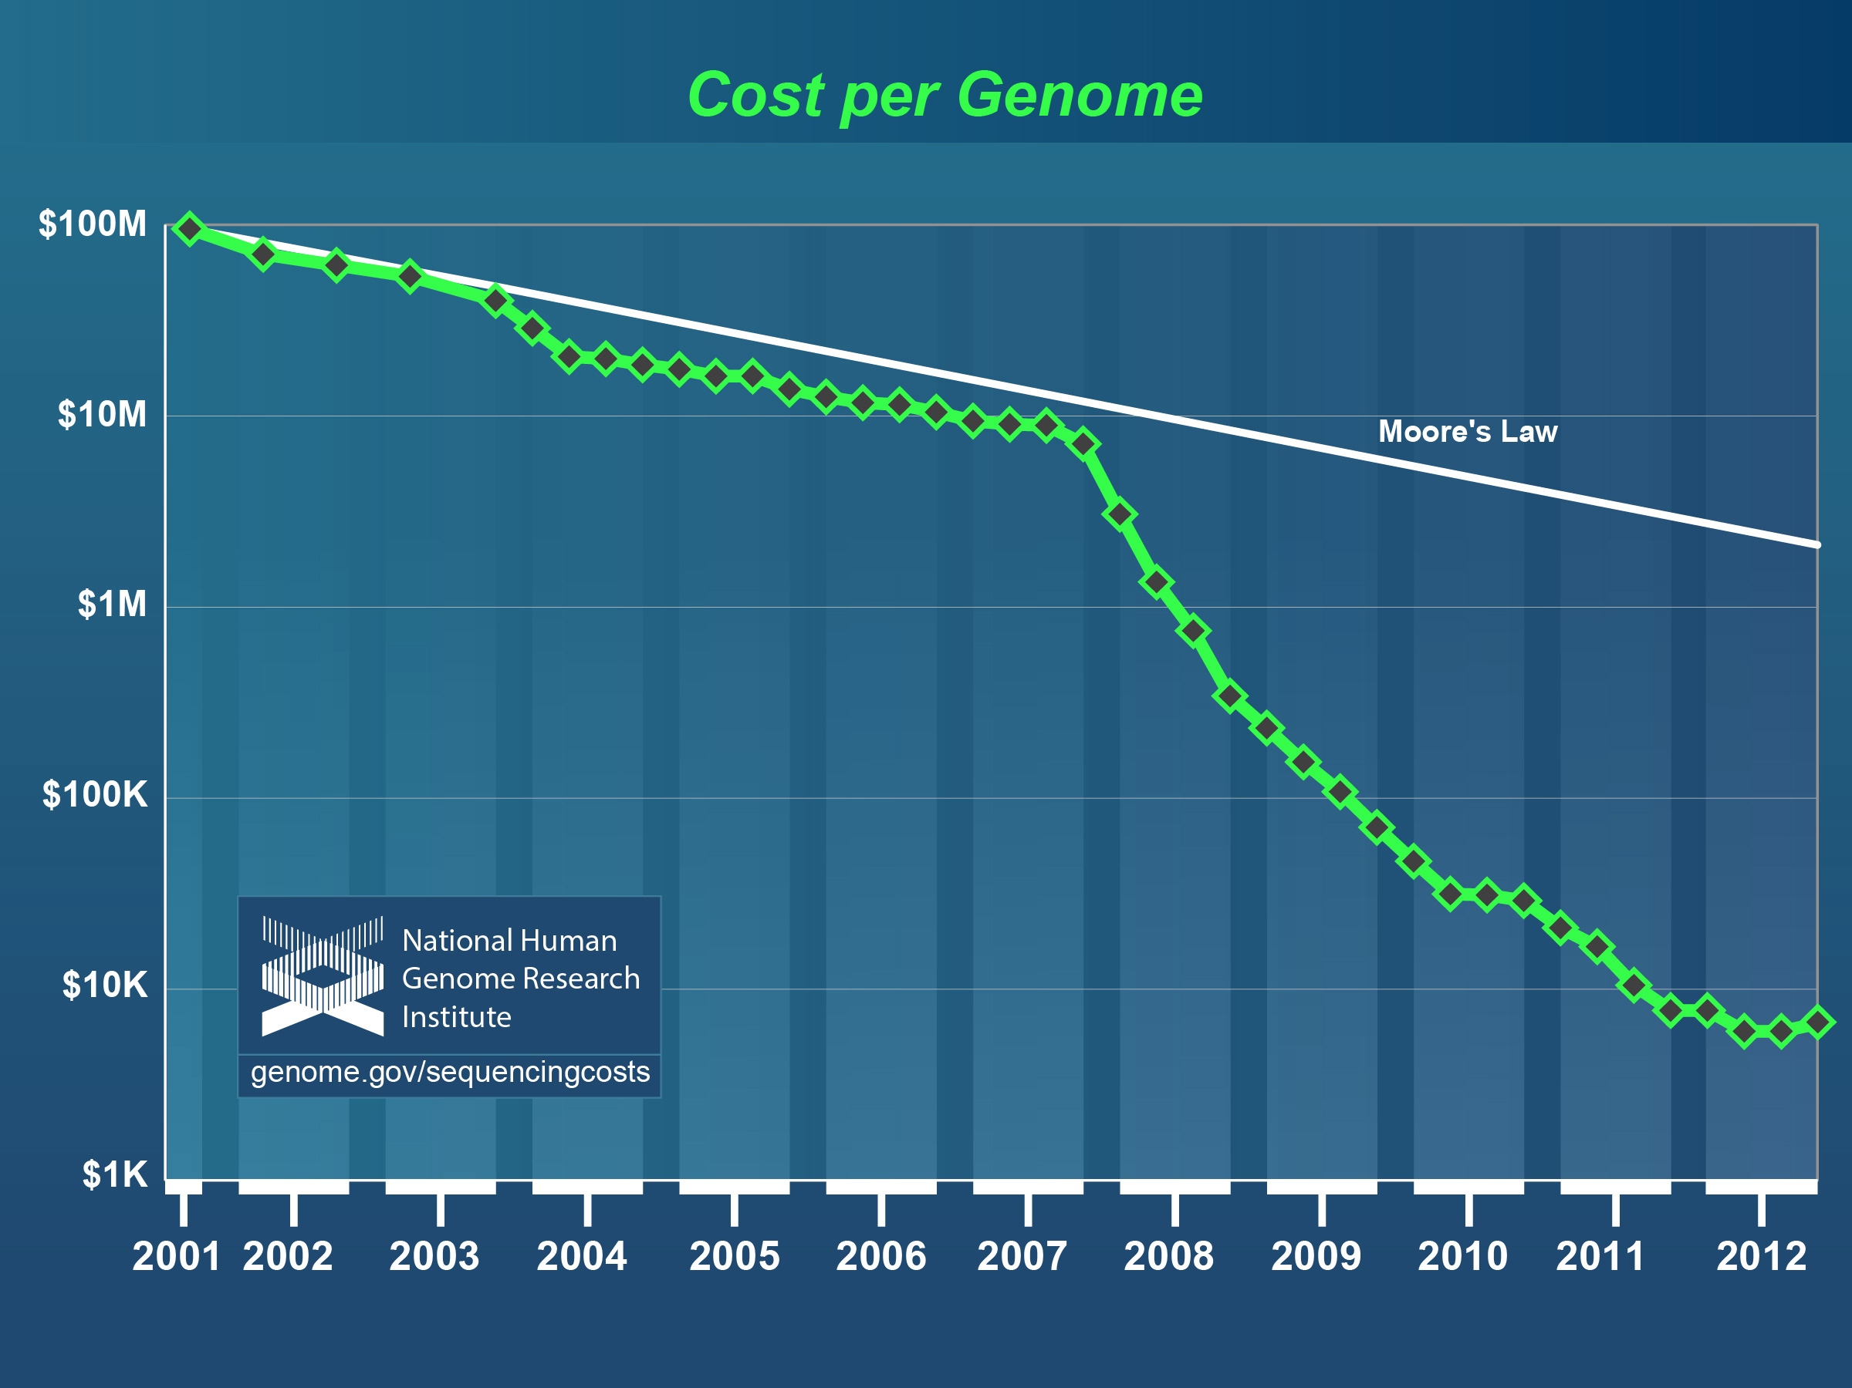

Slide 16
Genome Sequence Milestones
1977: First complete viral genome (5.4 Kb).
1995: First complete non-viral genomes: the bacteria Haemophilus influenzae (1.8 Mb) and Mycoplasma genitalium (0.6 Mb).
1997: First complete eukaryotic genome: yeast (12 Mb).
1998: First complete multi-cellular organism genome reported: roundworm (98 Mb).
2001: First complete human genome report (3 Gb).
2005: First complete chimp genome (~99% identical to human).
Notes:
16

Slide 17
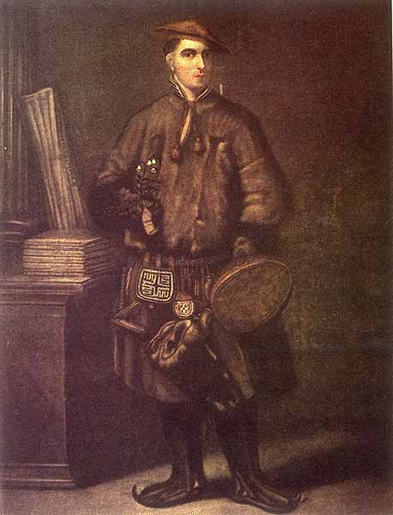
What are we learning?
Completing the dream of Linnaean-Darwinian biology
There are THREE kingdoms (not five or two).
Two of the three kingdoms (eubacteria and archaea) were lumped together just 20 years ago.
Eukaryotic cells are amalgams of symbiotic bacteria.
Demoted the human gene number from ~200,000 to about 20,000.
Establishing the evolutionary relations among our closest relatives.
Discovering the genetic “parts list” for a variety of organisms.
Discovering the genetic basis for many heritable diseases.
Carl Linnaeus, father of systematic classification

Slide 18
Motivation
Why align two protein or DNA sequences?

Slide 19
Motivation
Why align two protein or DNA sequences?
Determine whether they are descended from a common ancestor (homologous).
Infer a common function.
Locate functional elements (motifs or domains).
Infer protein structure, if the structure of one of the sequences is known.

Slide 20
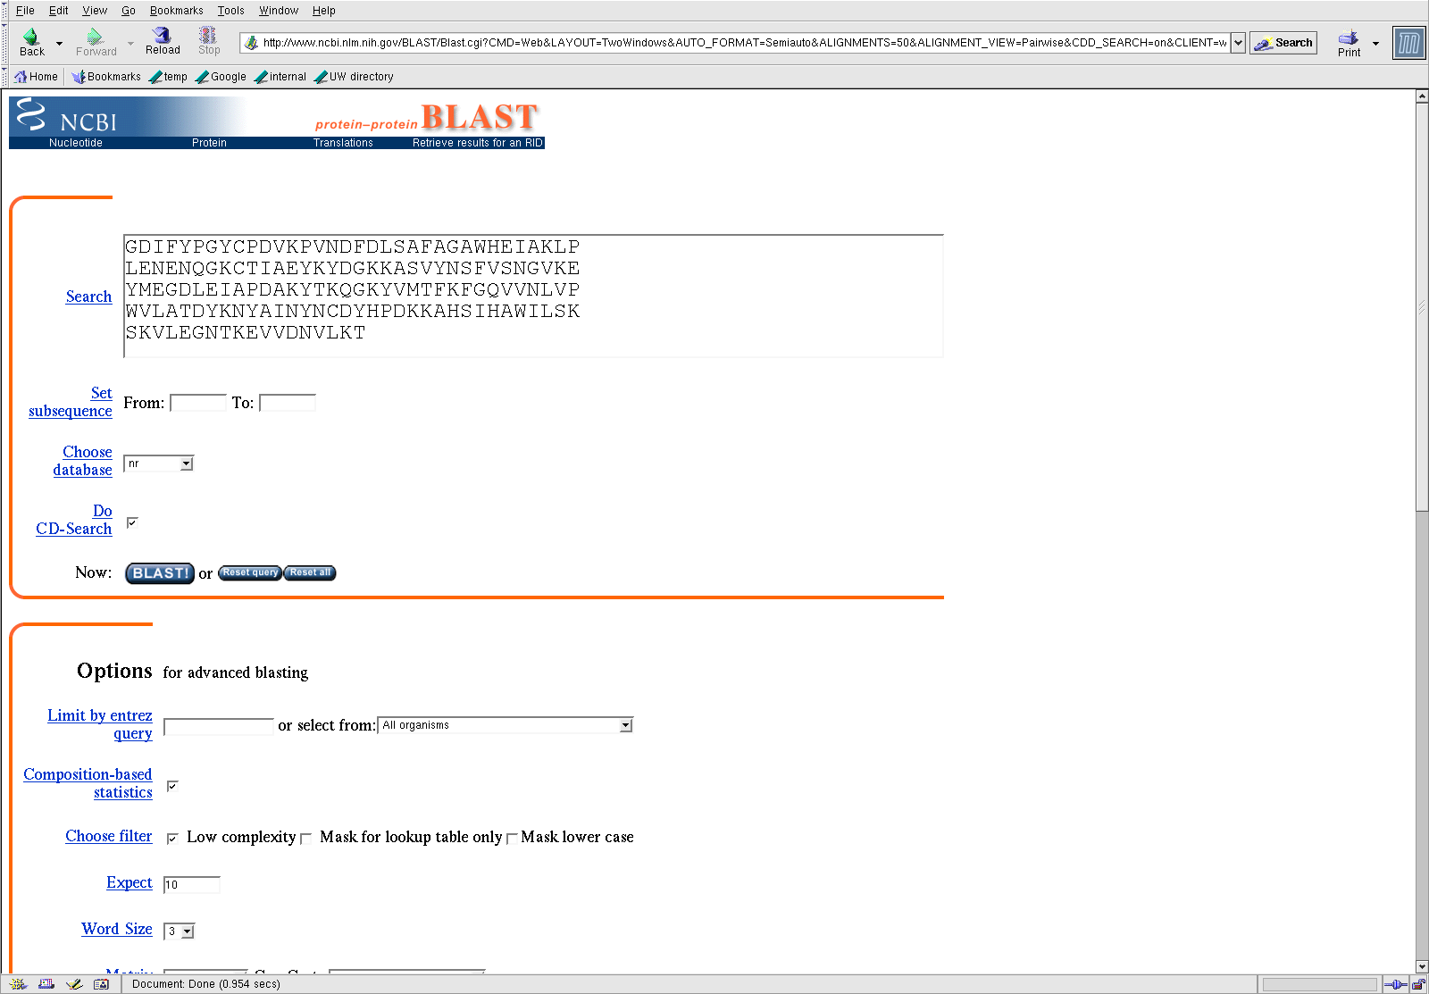

Slide 21
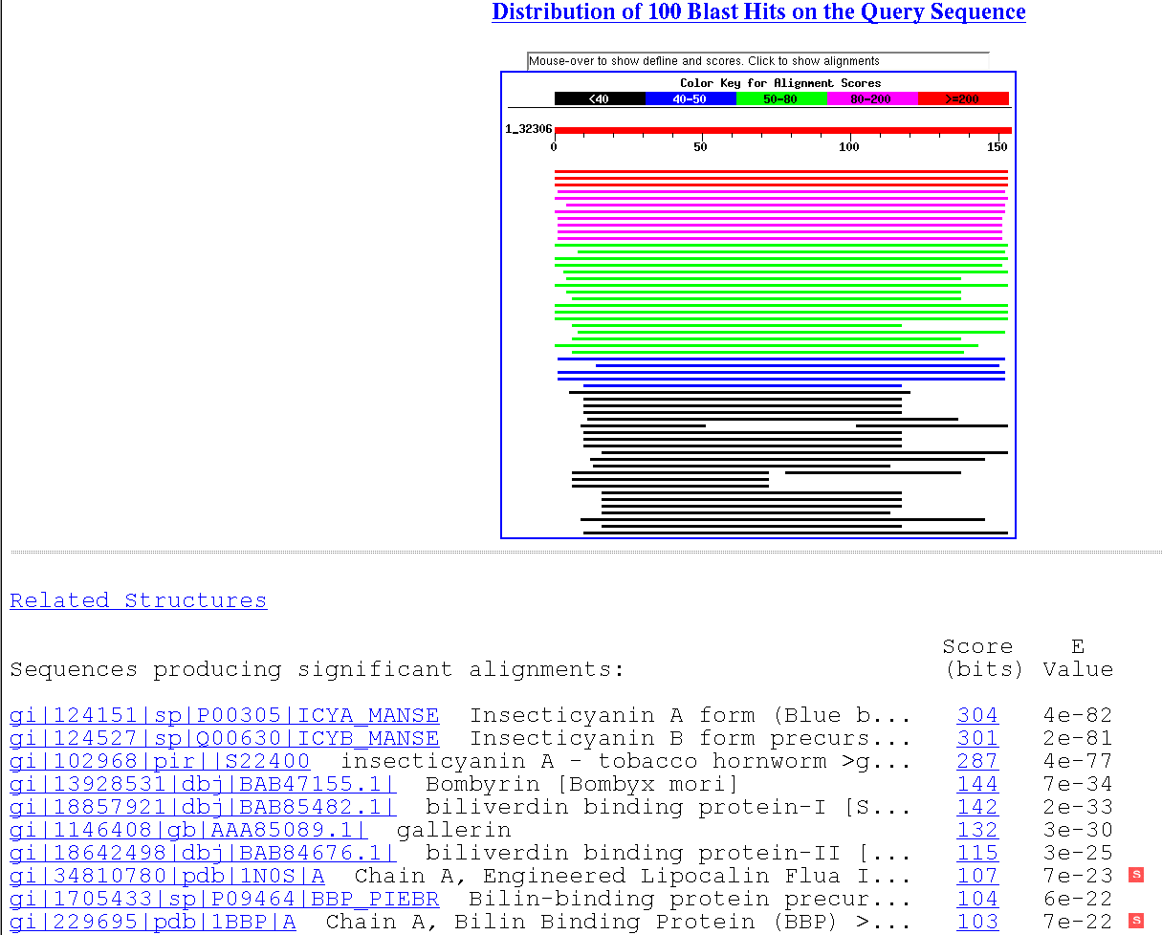

Slide 22
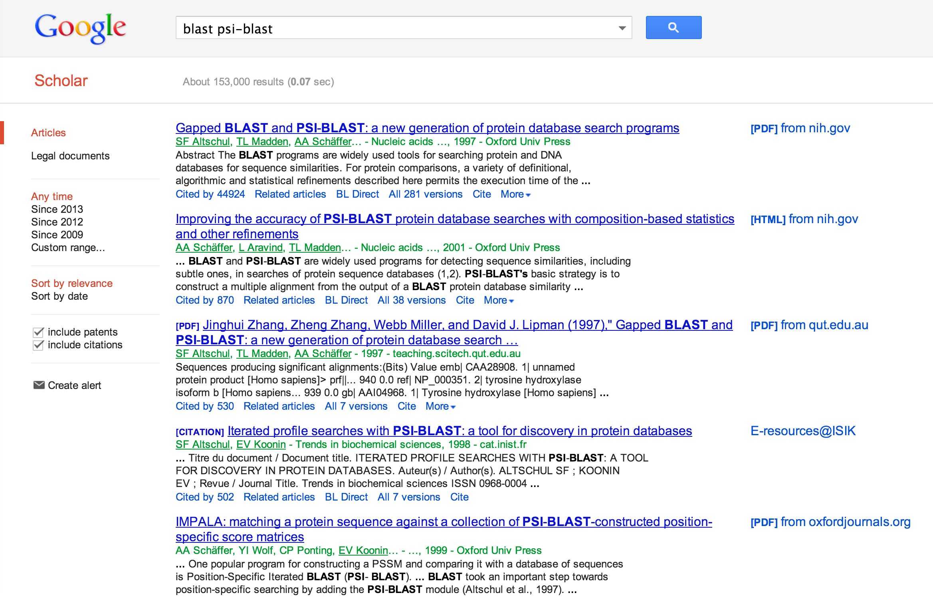

Slide 23
Sequence comparison overview
Problem: Find the “best” alignment between a query sequence and a target sequence.
To solve this problem, we need
a method for scoring alignments, and
an algorithm for finding the alignment with the best score.
The alignment score is calculated using
a substitution matrix, and
gap penalties.
The algorithm for finding the best alignment is dynamic programming.

Slide 24
A simple alignment problem.
Problem: find the best pairwise alignment of GAATC and CATAC.

Slide 25
Scoring alignments
GAATC
CATAC
GAAT-C
C-ATAC
-GAAT-C
C-A-TAC
GAATC-
CA-TAC
GAAT-C
CA-TAC
GA-ATC
CATA-C
We need a way to measure the quality of a candidate alignment.
Alignment scores consist of two parts: a substitution matrix, and a gap penalty.

Slide 26
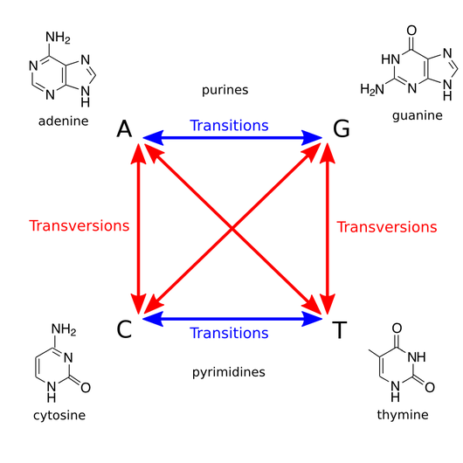
rosalind.info

Slide 27
Scoring aligned bases
A hypothetical substitution matrix:
 | A | C | G | T
A | 10 | -5 | 0 | -5
C | -5 | 10 | -5 | 0
G | 0 | -5 | 10 | -5
T | -5 | 0 | -5 | 10
GAATC
| |
CATAC
-5 + 10 + -5 + -5 + 10 = 5

Slide 28
BLOSUM 62
A R N D C Q E G H I L K M F P S T W Y V B Z X
A 4 -1 -2 -2 0 -1 -1 0 -2 -1 -1 -1 -1 -2 -1 1 0 -3 -2 0 -2 -1 0
R -1 5 0 -2 -3 1 0 -2 0 -3 -2 2 -1 -3 -2 -1 -1 -3 -2 -3 -1 0 -1
N -2 0 6 1 -3 0 0 0 1 -3 -3 0 -2 -3 -2 1 0 -4 -2 -3 3 0 -1
D -2 -2 1 6 -3 0 2 -1 -1 -3 -4 -1 -3 -3 -1 0 -1 -4 -3 -3 4 1 -1
C 0 -3 -3 -3 9 -3 -4 -3 -3 -1 -1 -3 -1 -2 -3 -1 -1 -2 -2 -1 -3 -3 -2
Q -1 1 0 0 -3 5 2 -2 0 -3 -2 1 0 -3 -1 0 -1 -2 -1 -2 0 3 -1
E -1 0 0 2 -4 2 5 -2 0 -3 -3 1 -2 -3 -1 0 -1 -3 -2 -2 1 4 -1
G 0 -2 0 -1 -3 -2 -2 6 -2 -4 -4 -2 -3 -3 -2 0 -2 -2 -3 -3 -1 -2 -1
H -2 0 1 -1 -3 0 0 -2 8 -3 -3 -1 -2 -1 -2 -1 -2 -2 2 -3 0 0 -1
I -1 -3 -3 -3 -1 -3 -3 -4 -3 4 2 -3 1 0 -3 -2 -1 -3 -1 3 -3 -3 -1
L -1 -2 -3 -4 -1 -2 -3 -4 -3 2 4 -2 2 0 -3 -2 -1 -2 -1 1 -4 -3 -1
K -1 2 0 -1 -3 1 1 -2 -1 -3 -2 5 -1 -3 -1 0 -1 -3 -2 -2 0 1 -1
M -1 -1 -2 -3 -1 0 -2 -3 -2 1 2 -1 5 0 -2 -1 -1 -1 -1 1 -3 -1 -1
F -2 -3 -3 -3 -2 -3 -3 -3 -1 0 0 -3 0 6 -4 -2 -2 1 3 -1 -3 -3 -1
P -1 -2 -2 -1 -3 -1 -1 -2 -2 -3 -3 -1 -2 -4 7 -1 -1 -4 -3 -2 -2 -1 -2
S 1 -1 1 0 -1 0 0 0 -1 -2 -2 0 -1 -2 -1 4 1 -3 -2 -2 0 0 0
T 0 -1 0 -1 -1 -1 -1 -2 -2 -1 -1 -1 -1 -2 -1 1 5 -2 -2 0 -1 -1 0
W -3 -3 -4 -4 -2 -2 -3 -2 -2 -3 -2 -3 -1 1 -4 -3 -2 11 2 -3 -4 -3 -2
Y -2 -2 -2 -3 -2 -1 -2 -3 2 -1 -1 -2 -1 3 -3 -2 -2 2 7 -1 -3 -2 -1
V 0 -3 -3 -3 -1 -2 -2 -3 -3 3 1 -2 1 -1 -2 -2 0 -3 -1 4 -3 -2 -1
B -2 -1 3 4 -3 0 1 -1 0 -3 -4 0 -3 -3 -2 0 -1 -4 -3 -3 4 1 -1
Z -1 0 0 1 -3 3 4 -2 0 -3 -3 1 -1 -3 -1 0 -1 -3 -2 -2 1 4 -1
X 0 -1 -1 -1 -2 -1 -1 -1 -1 -1 -1 -1 -1 -1 -2 0 0 -2 -1 -1 -1 -1 -1

Slide 29
Scoring gaps
Linear gap penalty: every gap receives a score of d.
Affine gap penalty: opening a gap receives a score of d; extending a gap receives a score of e.
GAAT-C d=-4
CA-TAC
-5 + 10 + -4 + 10 + -4 + 10 = 17
G--AATC d=-4
CATA--C e=-1
-5 + -4 + -1 + 10 + -4 + -1 + 10 = 5

Slide 30
A simple alignment problem.
Problem: find the best pairwise alignment of GAATC and CATAC.
Use a linear gap penalty of -4.
Use the following substitution matrix:
 | A | C | G | T
A | 10 | -5 | 0 | -5
C | -5 | 10 | -5 | 0
G | 0 | -5 | 10 | -5
T | -5 | 0 | -5 | 10

Slide 31
How many possibilities?
GAATC
CATAC
GAAT-C
C-ATAC
-GAAT-C
C-A-TAC
GAATC-
CA-TAC
GAAT-C
CA-TAC
GA-ATC
CATA-C
How many different alignments of two sequences of length N exist?

Slide 32
How many possibilities?
GAATC
CATAC
GAAT-C
C-ATAC
-GAAT-C
C-A-TAC
GAATC-
CA-TAC
GAAT-C
CA-TAC
GA-ATC
CATA-C
How many different alignments of two sequences of length n exist?
Too many to enumerate!

Slide 33
DP matrix
-G-
CAT
 |  | G | A | A | T | C
C
A
T
A
C
The value in position (i,j) is the score of the best alignment of the first i positions of the first sequence versus the first j positions of the second sequence.
-8

Slide 34
DP matrix
-G-A
CAT-
 |  | G | A | A | T | C
C
A
T |  | -8 | -12
A
C
Moving horizontally in the matrix introduces a gap in the sequence along the left edge.

Slide 35
DP matrix
-G--
CATA
 |  | G | A | A | T | C
C
A
T |  | -8
A |  | -12
C
Moving vertically in the matrix introduces a gap in the sequence along the top edge.

Slide 36
Initialization
 |  | G | A | A | T | C
 | 0
C
A
T
A
C

Slide 37
Introducing a gap
G
-
 |  | G | A | A | T | C
 | 0 | -4
C
A
T
A
C

Slide 38
DP matrix
-
C
 |  | G | A | A | T | C
 | 0 | -4
C | -4
A
T
A
C

Slide 39
DP matrix
 |  | G | A | A | T | C
 | 0 | -4
C | -4 | -8
A
T
A
C

Slide 40
DP matrix
G
C
 |  | G | A | A | T | C
 | 0 | -4
C | -4 | -5
A
T
A
C

Slide 41
DP matrix
-----
CATAC
 |  | G | A | A | T | C
 | 0 | -4 | -8 | -12 | -16 | -20
C | -4 | -5
A | -8
T | -12
A | -16
C | -20

Slide 42
DP matrix
 |  | G | A | A | T | C
 | 0 | -4 | -8 | -12 | -16 | -20
C | -4 | -5
A | -8 | ?
T | -12
A | -16
C | -20

Slide 43
DP matrix
-G
CA
G-
CA
--G
CA-
-4
-9
-12
 |  | G | A | A | T | C
 | 0 | -4 | -8 | -12 | -16 | -20
C | -4 | -5
A | -8 | -4
T | -12
A | -16
C | -20
0
-4
-4

Slide 44
DP matrix
 |  | G | A | A | T | C
 | 0 | -4 | -8 | -12 | -16 | -20
C | -4 | -5
A | -8 | -4
T | -12 | ?
A | -16 | ?
C | -20 | ?

Slide 45
DP matrix
 |  | G | A | A | T | C
 | 0 | -4 | -8 | -12 | -16 | -20
C | -4 | -5
A | -8 | -4
T | -12 | -8
A | -16 | -12
C | -20 | -16

Slide 46
DP matrix
 |  | G | A | A | T | C
 | 0 | -4 | -8 | -12 | -16 | -20
C | -4 | -5 | ?
A | -8 | -4 | ?
T | -12 | -8 | ?
A | -16 | -12 | ?
C | -20 | -16 | ?

Slide 47
DP matrix
 |  | G | A | A | T | C
 | 0 | -4 | -8 | -12 | -16 | -20
C | -4 | -5 | -9
A | -8 | -4 | 5
T | -12 | -8 | 1
A | -16 | -12 | 2
C | -20 | -16 | -2
What is the alignment associated with this entry?

Slide 48
DP matrix
 |  | G | A | A | T | C
 | 0 | -4 | -8 | -12 | -16 | -20
C | -4 | -5 | -9
A | -8 | -4 | 5
T | -12 | -8 | 1
A | -16 | -12 | 2
C | -20 | -16 | -2
-G-A
CATA

Slide 49
DP matrix
 |  | G | A | A | T | C
 | 0 | -4 | -8 | -12 | -16 | -20
C | -4 | -5 | -9
A | -8 | -4 | 5
T | -12 | -8 | 1
A | -16 | -12 | 2
C | -20 | -16 | -2 |  |  | ?
Find the optimal alignment, and its score.

Slide 50
DP matrix
 |  | G | A | A | T | C
 | 0 | -4 | -8 | -12 | -16 | -20
C | -4 | -5 | -9 | -13 | -12 | -6
A | -8 | -4 | 5 | 1 | -3 | -7
T | -12 | -8 | 1 | 0 | 11 | 7
A | -16 | -12 | 2 | 11 | 7 | 6
C | -20 | -16 | -2 | 7 | 11 | 17

Slide 51
DP matrix
GA-ATC
CATA-C
 |  | G | A | A | T | C
 | 0 | -4 | -8 | -12 | -16 | -20
C | -4 | -5 | -9 | -13 | -12 | -6
A | -8 | -4 | 5 | 1 | -3 | -7
T | -12 | -8 | 1 | 0 | 11 | 7
A | -16 | -12 | 2 | 11 | 7 | 6
C | -20 | -16 | -2 | 7 | 11 | 17

Slide 52
DP matrix
GAAT-C
CA-TAC
 |  | G | A | A | T | C
 | 0 | -4 | -8 | -12 | -16 | -20
C | -4 | -5 | -9 | -13 | -12 | -6
A | -8 | -4 | 5 | 1 | -3 | -7
T | -12 | -8 | 1 | 0 | 11 | 7
A | -16 | -12 | 2 | 11 | 7 | 6
C | -20 | -16 | -2 | 7 | 11 | 17

Slide 53
DP matrix
GAAT-C
C-ATAC
 |  | G | A | A | T | C
 | 0 | -4 | -8 | -12 | -16 | -20
C | -4 | -5 | -9 | -13 | -12 | -6
A | -8 | -4 | 5 | 1 | -3 | -7
T | -12 | -8 | 1 | 0 | 11 | 7
A | -16 | -12 | 2 | 11 | 7 | 6
C | -20 | -16 | -2 | 7 | 11 | 17

Slide 54
DP matrix
GAAT-C
-CATAC
 |  | G | A | A | T | C
 | 0 | -4 | -8 | -12 | -16 | -20
C | -4 | -5 | -9 | -13 | -12 | -6
A | -8 | -4 | 5 | 1 | -3 | -7
T | -12 | -8 | 1 | 0 | 11 | 7
A | -16 | -12 | 2 | 11 | 7 | 6
C | -20 | -16 | -2 | 7 | 11 | 17

Slide 55
Multiple solutions
GA-ATC
CATA-C
When a program returns a sequence alignment, it may not be the only best alignment.
GAAT-C
CA-TAC
GAAT-C
C-ATAC
GAAT-C
-CATAC

Slide 56
DP in equation form
Align sequence x and y.
F is the DP matrix; s is the substitution matrix; d is the linear gap penalty.

Slide 57
DP in equation form

Slide 58
Dynamic programming
Yes, it’s a weird name.
DP is closely related to recursion and to mathematical induction.
We can prove that the resulting score is optimal.

Slide 59
Summary
Scoring a pairwise alignment requires a substition matrix and gap penalties.
Dynamic programming is an efficient algorithm for finding the optimal alignment.
Entry (i,j) in the DP matrix stores the score of the best-scoring alignment up to those positions.
DP iteratively fills in the matrix using a simple mathematical rule.

Slide 60
One-minute response
At the end of each class
Write for about one minute.
Provide feedback about the class.
Was part of the lecture unclear?
What did you like about the class?
Do you have unanswered questions?
Sign your name
I will begin the next class by responding to the one-minute responses

